Slide 1
Mini Tutorial 3B Introduction to Neural Networks for Deep Learning with TensorFlow
Roshan Patel, roshan.r.patel2.civ@mail.mil
US ARMY CCDC Armaments Center
2021-04-14 1300-1430

Slide 2

Hello
MS Computer Science, Rutgers University. BS Mechanical and Aerospace Engineering, Rutgers University.
Engineer at CCDC Armaments Center focusing on systems engineering infrastructure, statistical modeling, and the analysis of weapon systems
System Engineering Directorate’s AI lead
Strategist and project coordinator
Consultant for AI and ML applications
Roshan Patel
Systems Engineer, Data Scientist

Slide 3
Abstract
Deep learning techniques are becoming more prevalent throughout the development of autonomous and AI-enabled systems, and this session will provide students with the foundational intuition needed to understand these systems.
In this mini-tutorial, we will
discuss artificial neural networks from a lay person’s perspective
walk through a simple implementation using Google’s TensorFlow

Slide 4
Agenda
1305-1325: Module 0 – Background and context
1325-1345: Module 1 – Deep learning theory
1345-1350: Break (questions)
1350-1400: Module 2 – Implementation with TensorFlow
1400-1420: Module 2 – Hands-on demonstration
1420-1430: Questions & Discussion

Slide 5
Module 0 Background and context

Slide 6
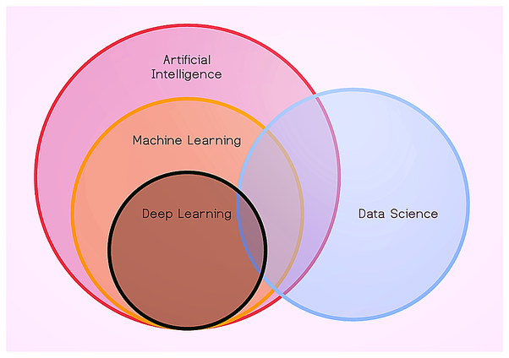
Common Buzzword
Artificial Intelligence (AI)
The study of agents that perceive the world around them, form plans, and make decisions to achieve their goals
Machine Learning (ML)
A subfield of AI; The study of programs that learn patterns from observed data and make predictions without explicit pre-programmed rules
An ML project will usually result in software
Data Science (DS)
The science of extracting knowledge and insights from data
A DS project will usually result in a slide-deck/presentation
Deep Learning (DL)
A subfield of ML focusing on use of artificial neural network models
Artificial Neural Network (NN)
A mathematical function whose original design is vaguely inspired by biological neural networks
https://towardsdatascience.com/a-beginners-guide-to-data-science-55edd0288973
Notes:
AI software solves problems without being preprogrammed explicitly
“Agent” = software + policy
ML = data-driven
Reinforcement learning – agent in environment maximizing heuristic notion of reward
AI = software, DS = report
Algorithm = procedure, steps to do something

Slide 7
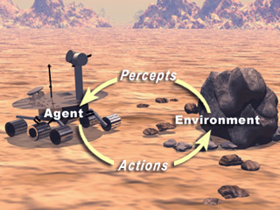
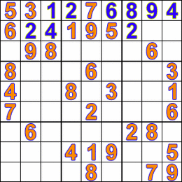
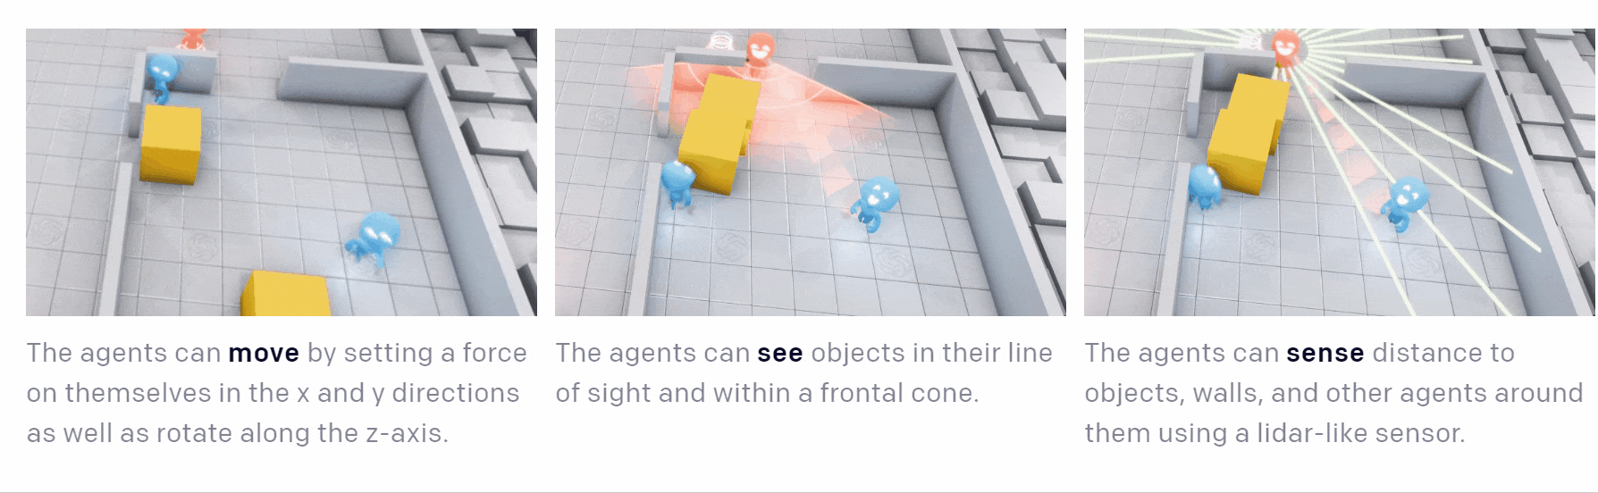
AI as a logical, symbolic agent
Traditional artificial intelligence seeks to build logical agents that have a symbolic representation of their environment.
They leverage:
Efficient search strategies
Expert domain knowledge
Formal logic
https://openai.com/blog/emergent-tool-use/ https://commons.wikimedia.org/wiki/File:Sudoku_solved_by_bactracking.gif
Notes:
Seek to build a symbolic description of problem space. (e.g. SysML model)
Agent is software that can logically navigate the problem space.
+ Percepts, actions

Slide 8
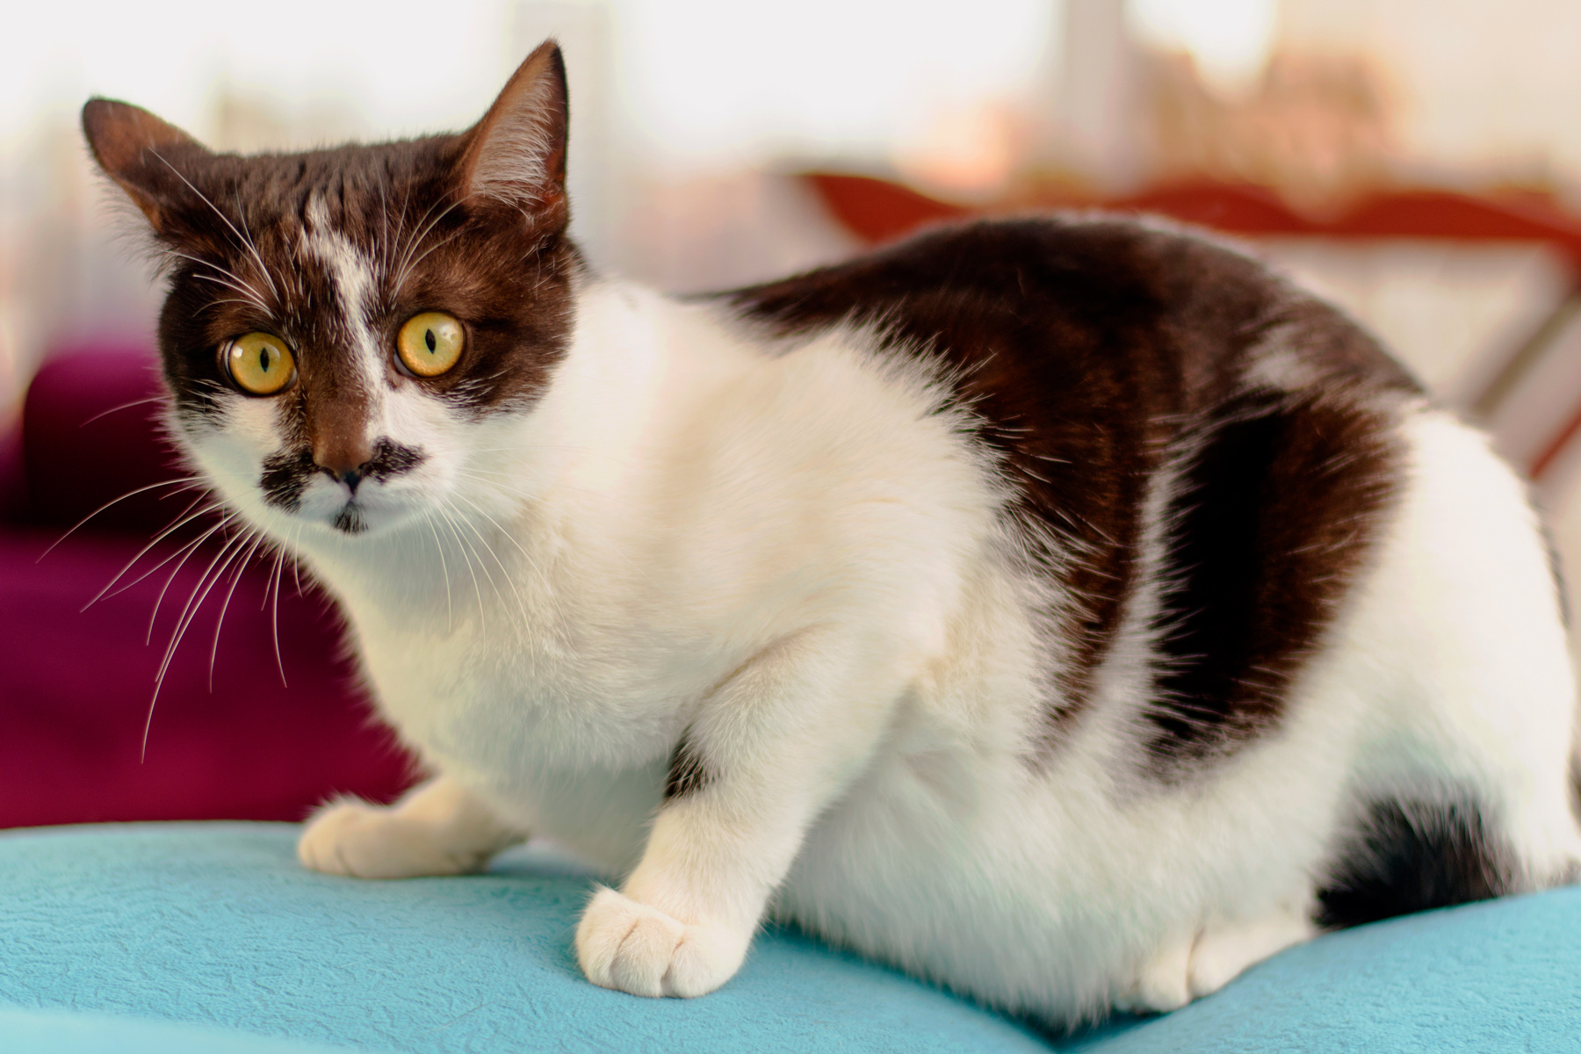


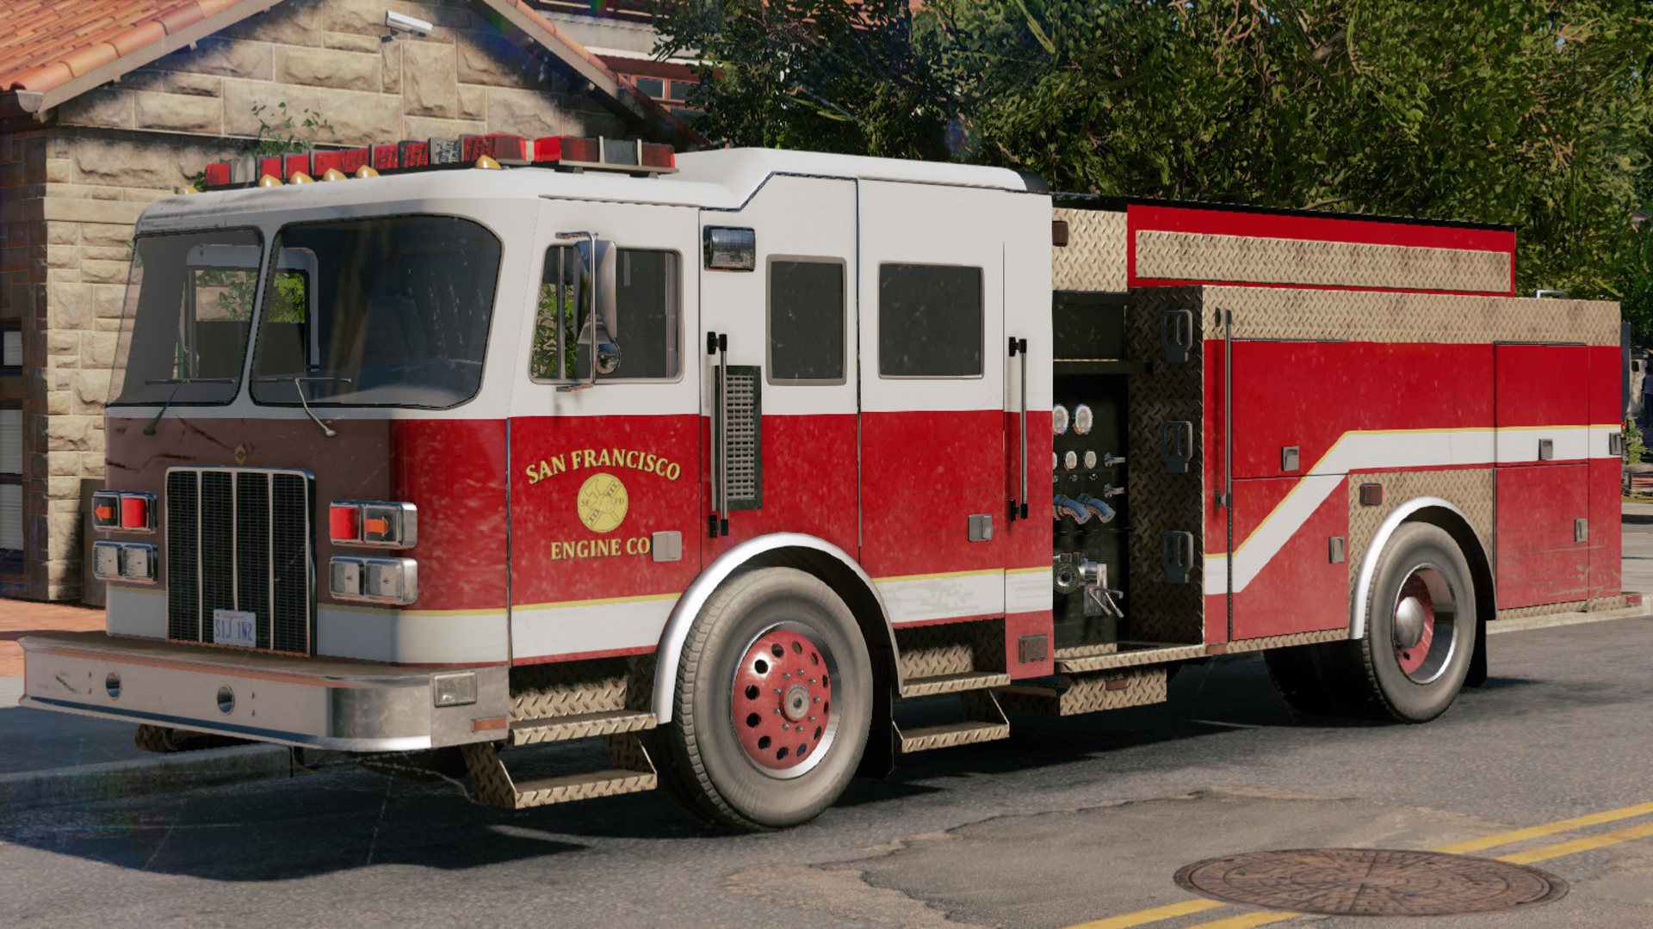


Symbolic AI vs Machine Learning Approach
Notes:
Consider building an image classifier for cats.
Compare the strategies of a symbolic agent and a machine learning model.
A symbolic agent would attempt to logically describe a cat. What do whiskers, eyes, ears, nose etc. of a cat look like? How could they be shown in images? Account for different colors and shapes of cats. So many rules and exceptions to the rules. It would be nearly impossible to build this.
Machine learning seeks to look at enough images of cats to learn its own patterns.

Slide 9
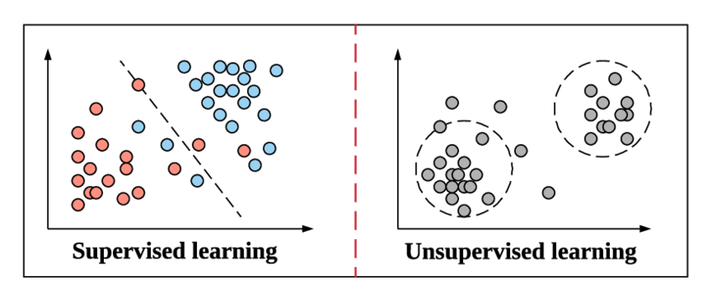
Machine Learning
Machine learning (ML) is a data-driven approach to modeling
Two categories:
Supervised learning: Build predictive models from historical data
Unsupervised learning: Looks for previously undetected patterns or structure in data
Rather than logically modeling nature, ML assumes the model using data.
A
B
input
output
https://www.researchgate.net/figure/Examples-of-Supervised-Learning-Linear-Regression-and-Unsupervised-Learning_fig3_336642133
Notes:
Majority of economic value comes from supervised learning

Slide 10
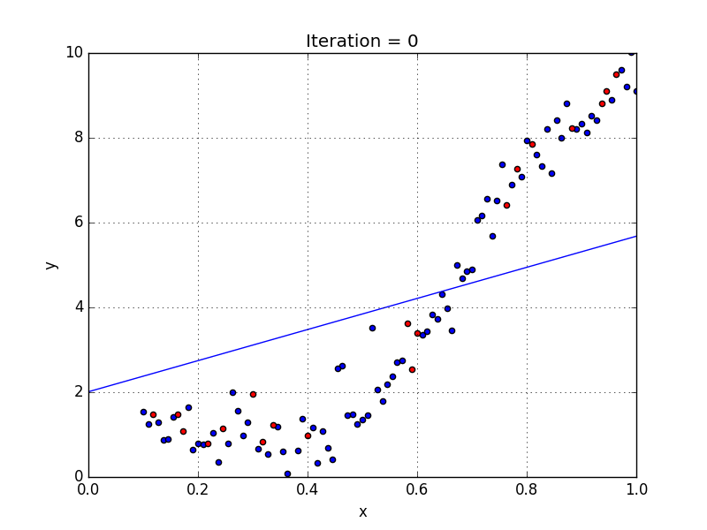
Learning
What does it mean for the mathematical model to learn?
Start with a random model
Check it’s performance on a training dataset
Apply a small correction
Repeat 2 & 3 until model is acceptable
This iterative process is called gradient descent.
Learning is improving performance on a dataset.

Slide 11
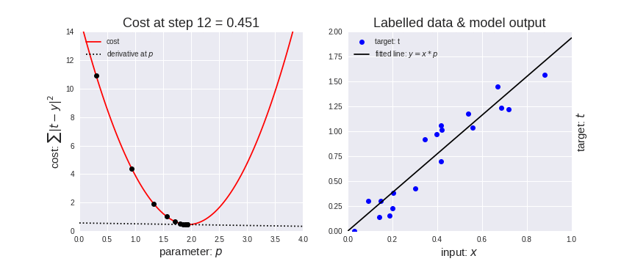
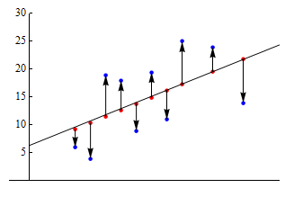
Learning via Gradient Descent
Gradient descent is used to identify a model that minimizes prediction error.
See the example below where the y-intercept is fixed.
We select a candidate model and calculate its error on the data
Based on how wrong it was, we will adjust the slope of the line and repeat
Gradient descent tells us which direction to adjust the slope (- or +)

Slide 12

Learning via Gradient Descent
In this example, we do not restrict the y-intercept term—therefore, it also needs to be adjusted each iteration.
We apply gradient descent along two variables to optimize error.

Slide 13
Module 1 Deep Learning Theory

Slide 14
Deep Learning Terminology
“Deep learning” refers to machine learning methods that involve artificial neural networks.
A neural networks is essentially a very complicated mathematical function.
height
blood pressure
weight
avg. heart rate
Artificial Neural Network

Slide 15
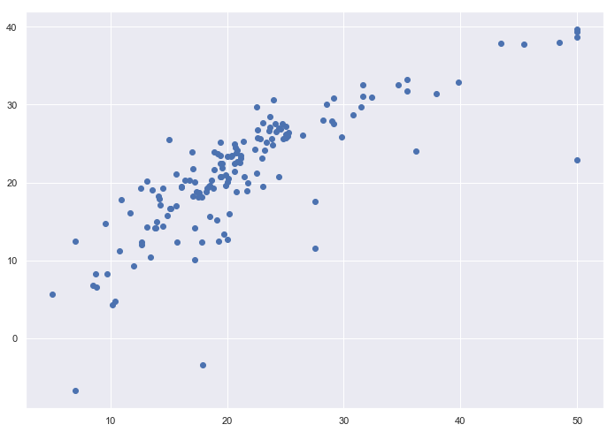
Artificial neural Network
Suppose we are trying to predict price of a home using size.
This is a simple neural network. It takes in size and computes price.
The neuron represents a linear combination (a=mx+b) and an activation function (o=g(a)) .
size
price
Price ($1000s)
“neuron”
“compute node”
Size (sq. ft.)
Notes:
Classification example—credit score to predict loan approval.

Slide 16
Artificial Neural Network
Consider that we have data to help us predict the likelihood that an individual will be admitted into a hospital within a year.
age
# of prescription drugs
likelihood of admittance
profession
location
https://www.coursera.org/learn/ai-for-everyone

Slide 17
Artificial Neural Network
Consider that we have data to help us predict the likelihood that an individual will be admitted into a hospital within a year.
age
chronic illness
# of prescription drugs
chance of accident
likelihood of admittance
profession
exposure to toxins
location
The process of deriving useful intermediate variables is called feature engineering
https://www.coursera.org/learn/ai-for-everyone

Slide 18

NN are Black Boxes
We design networks with a representation in mind, but the network will learn any representation that helps it reduce error.
These representations are often hard to decipher—making neural networks black box models.
Planned
Actual
age
chronic illness
age
?
# of prescription drugs
likelihood of admittance
# of prescription drugs
?
?
likelihood of admittance
chance of accident
profession
profession
?
exposure to toxins
location
location
Neural network tradeoff: Hard to interpret, but very effective at feature engineering.
Notes:
The pattern that the hidden nodes pick up on are extremely difficult to decipher. This is why it is considered a black-box algorithm.
It is unlikely that they will hone in on human constructs unless we very carefully design the network inputs so that they do.
But the strength of neural networks is that they can figure out the internal values for you (although not necessarily interpretable).

Slide 19
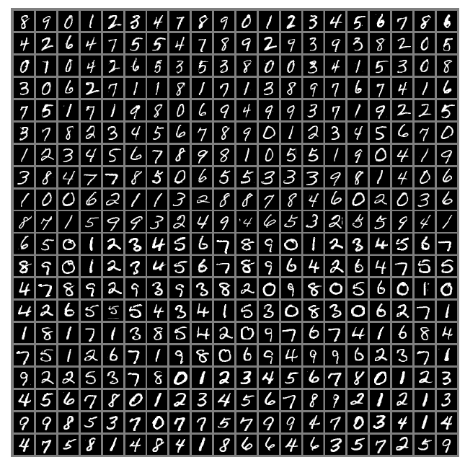
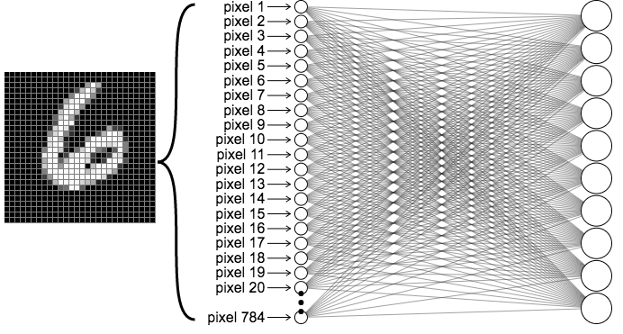
Artificial neural Network – Handwritten Digits
Another example:
Consider a dataset of handwritten digits. We want to build a neural network that can determine what digit is contained in an image.
Each image is a 28x28 pixel image, so our input will be 784 values.
https://en.wikipedia.org/wiki/MNIST_database

Slide 20
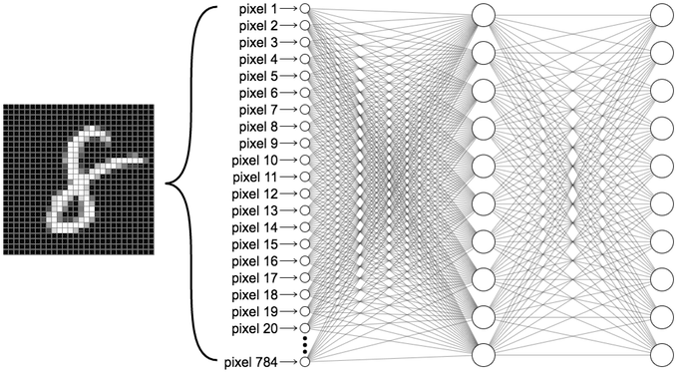
Artificial neural Network – Handwritten Digits
Let’s use an architecture with two hidden layers.
> What can we hope that the hidden layers try to model?
0
1
2
.
.
.
9

Slide 21
Artificial neural Network – Handwritten Digits
> What can we hope that the hidden layers try to model?
Straight lines, semi-circles, round loops, …
Straight edges, round edges, …
0
1
2
.
.
.
9

Slide 22
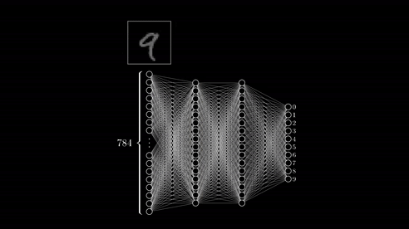
https://www.youtube.com/watch?v=aircAruvnKk

Slide 23
Artificial neural Network – Handwritten Digits
> What can we hope that the hidden layers try to model?
Straight lines, semi-circles, round loops, …
Straight edges, round edges, …
1
2
3
.
.
.
9

Slide 24
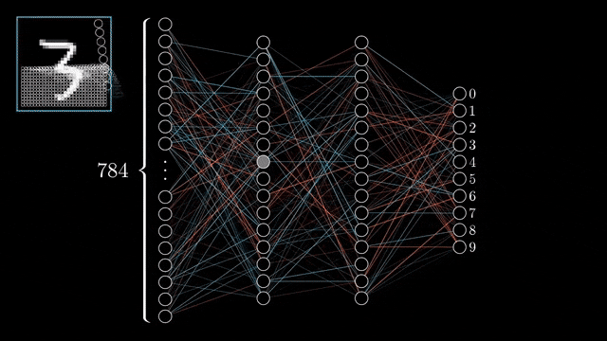
Artificial neural Network Learning
> How does the neural network “learn”?
It uses gradient descent!
[top image] Start with a random model
[top image] Check it’s performance on a training dataset
[bottom image] Propagate small corrections through the network
Repeat 2 & 3 until model is acceptable
https://www.youtube.com/watch?v=aircAruvnKk

Slide 25
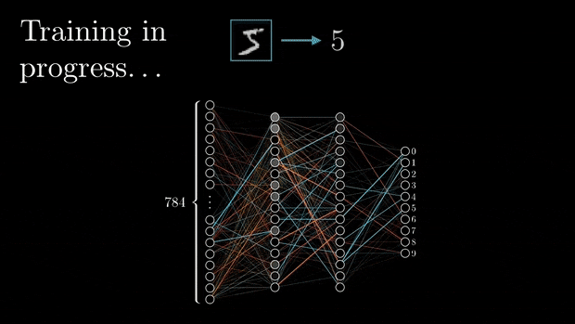
Artificial neural Network Learning
> How does the neural network “learn”?
It uses gradient descent!
[top image] Start with a random model
[top image] Check it’s performance on a training dataset
[bottom image] Propagate small corrections through the network
Repeat 2 & 3 until model is acceptable
https://www.youtube.com/watch?v=aircAruvnKk

Slide 26
Neural Network Advantages
Feature engineering (figuring out internal data patterns) is done for you
Can learn very complex patterns
For complex problems, accuracy increases as dataset size grows
Transfer learning : A neural network that was trained to recognize edges in cat photos can be used as the starting point for other similar problems (e.g. recognizing tigers)
Quick to predict in comparison to traditional agent-based programs (recall Chess bot).

Slide 27
Neural Network Disadvantages
Extremely computationally expensive. Often necessitate custom hardware (GPU clusters)
Black-box algorithm. It is very difficult to interpret or explain the behavior of a neural network model
Crafting an architecture to suit a problem is difficult
Dependent on having massive amounts of data to train on (1 million+ data points)

Slide 28
Questions So Far?
?

Slide 29
Module 2 Implementation Using TensorFlow

Slide 30




Google Brain’s TensorFlow
TensorFlow is a free and open-source software library developed by Google for symbolic math based on dataflow and differentiable programming. It excels at managing compute graphs for large-scale mathematical models.
It is widely used for training and inference of deep learning models.
Interfaces are written for high-level languages (such as Python and Java), but TensorFlow performs computations using high-performance C++ binaries.

Slide 31
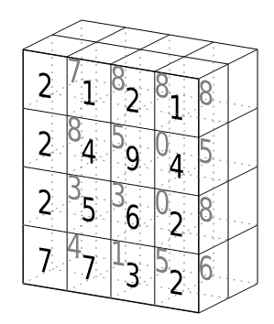
Dataflow Computational Graphs
TensorFlow represents models as computational graphs of math operations applied to placeholder variables. These variables are tensors at execution time, or n-dimensional arrays of numeric values.
a
DOT_PRODUCT
ADD
DOT_PROD
b
c
d
https://www.tensorflow.org/guide/intro_to_graphs

Slide 32
Demo
Jupyter notebook demonstrations

Slide 33
TensorFlow Model Building Steps
The following three steps can be used to define simple neural network models using TensorFlow.
# DEFINE MODEL ARCHITECTURE
> model = tf.keras.Sequential([
Dense(units=10, activation=‘sigmoid’),
Dense(units=1, activation=‘sigmoid’)
])
# COMPILE MODEL
> model.compile(optimizer=‘sgd’,
loss=‘binary_crossentropy’,
metrics=[‘accuracy’]
# RUN TRAINING
> model.fit(X_train, y_train, epochs=100)

Slide 34
BACKUP

Slide 35
Data
Data is important for building machine learning systems.
___________________________
You are trying to build a machine learning model to predict the price of a house given its size and the number of bedrooms it has.
To use for machine learning, the data must be in tabular form.
Size of house (sq. ft.) | # of bedrooms | Price ($1000s)
503 | 1 | 215
645 | 2 | 392
1039 | 2 | 405
2490 | 4 | 503
3504 | 4 | 550
A
B
Notes:
Note that data is labeled. Note that response variable is a column. Note that data is tabular
Supervised learning problem – predicting price
Unsupervised learning problem – cluster homes into groups

Slide 36
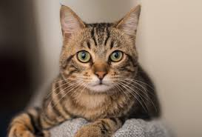
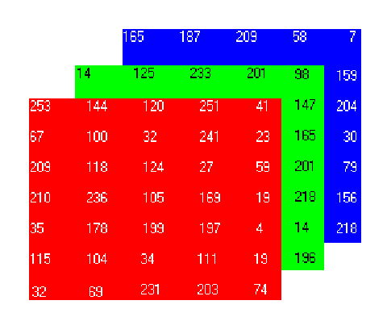


Data
Another example for an image recognition problem
Image matrix | Cat
= [ 251, 144, 123, 54, 123, 213, 19 ... ] | 1
= [ 123, 213, 38, 149, 194, 93, 139, ... ] | 0
= [ 123, 211, 142, 175, 145, 120, 49, ... ] | 1
… | …
=
A color image is just a matrix of numbers. This is the data in the first column stacked into one array.
A
B

Slide 37
Data
red_pixel_1,1 | red_pixel_1,2 | red_pixel_1,3 | … | green_pixel_n,n | Cat
251 | 144 | 54 |  | 124 | 1
123 | 213 | 134 |  | 43 | 0
123 | 211 | 143 |  | 241 | 1
… |  |  |  |  | …

Slide 38
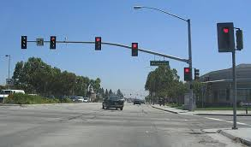
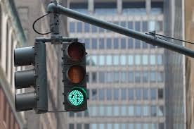
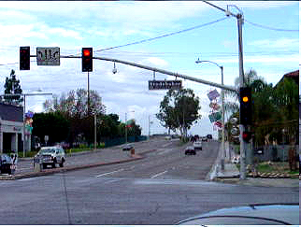
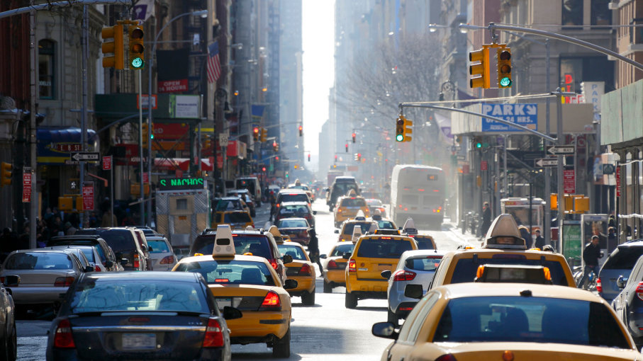
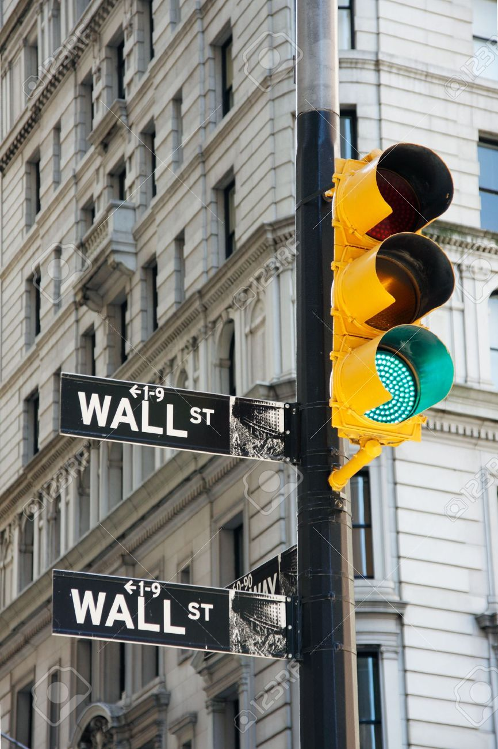
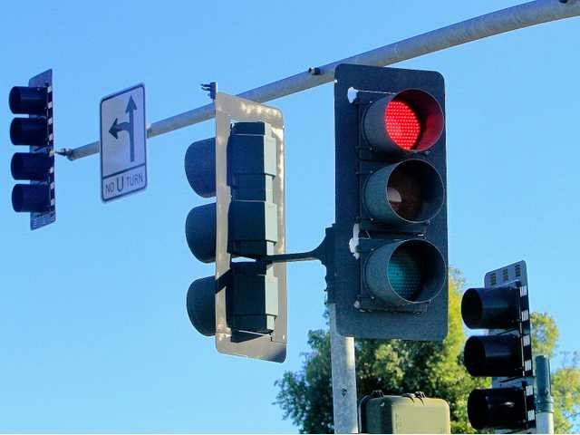
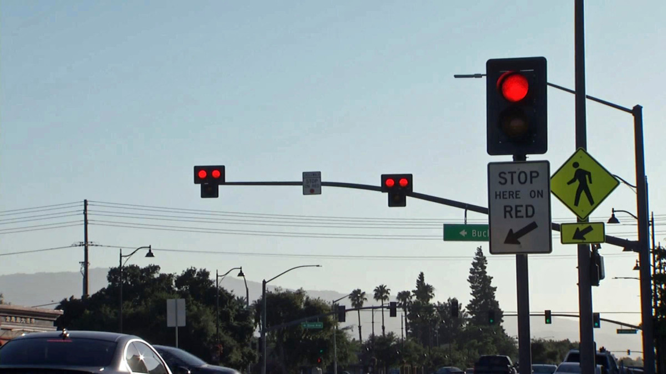
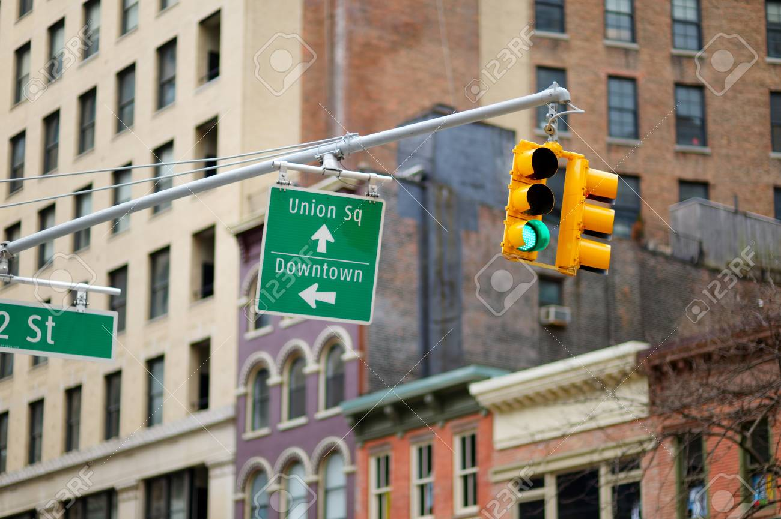
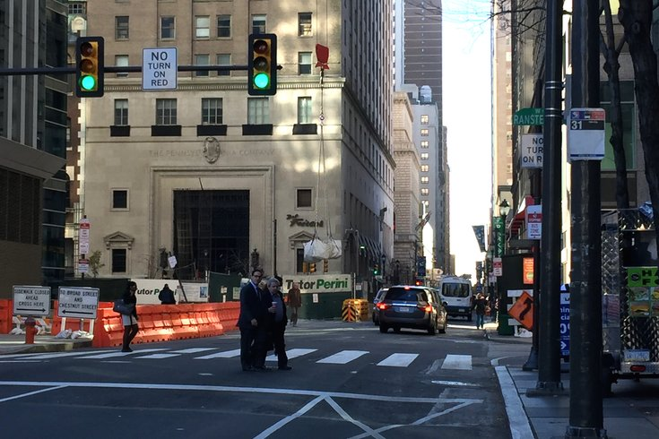
Data Integrity
Machine learning models are sensitive to perturbations and imbalances in the dataset. Biases in data will manifest as meaningful attributes in the model—that’s the point.
We want to build a program that can detect red and green stoplights. Consider this dataset of stoplight images on this slide.
Do you have any data integrity concerns?
Notes:
Green lights have city backgrounds. Red lights do not. ML model may fit to this pattern rather than the response we care about (stoplight color)

Slide 39
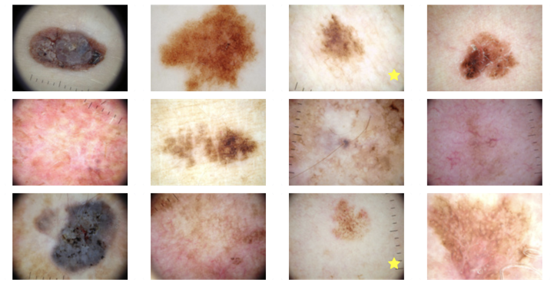
Data Integrity
Another example:
Consider a program that takes a photo of a skin abnormality and predicts if it is cancerous or benign.
Warning: Images of skin abnormalities
Dermatologists often use a ruler to measure the size of a skin lesion in the photo if they’re particularly concerned about it, so a photo with a ruler in it is more likely to be cancerous
Do you have any data integrity concerns?
Notes:
The presence of a ruler in the image is likely to be correlated to cancerous tumors. ML models may pick up on this as a feature to help it discriminate between benign and cancerous tumors.

Slide 40
Data Integrity
Another example:
Consider a program that takes a photo of a skin abnormality and predicts if it is cancerous or benign.
Dermatologists often use a ruler to measure the size of a skin lesion in the photo if they’re particularly concerned about it, so a photo with a ruler in it is more likely to be cancerous
Do you have any data integrity concerns?
Notes:
The presence of a ruler in the image is likely to be correlated to cancerous tumors. ML models may pick up on this as a feature to help it discriminate between benign and cancerous tumors.

Slide 41
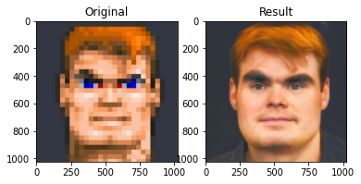
Data Integrity
Another example again:
Consider a program that takes a pixelated photo of a person and upscales it to a high-res portrait.
The program will be trained on a dataset of LinkedIn profile pictures from users from the United States.
Do you have any data integrity concerns?
https://www.theverge.com/21298762/face-depixelizer-ai-machine-learning-tool-pulse-stylegan-obama-bias Note…This article is kind of click bait.

Slide 42
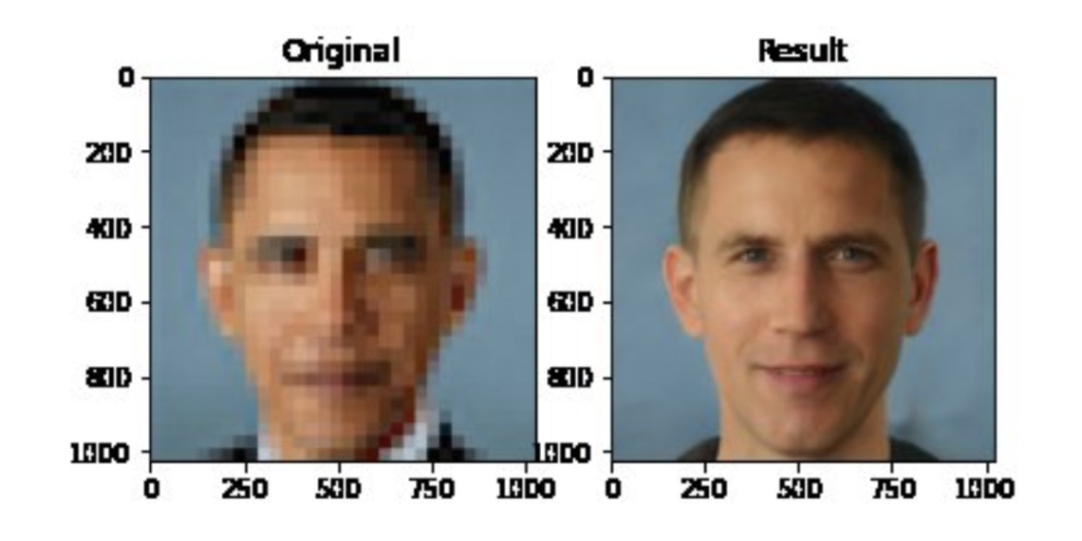
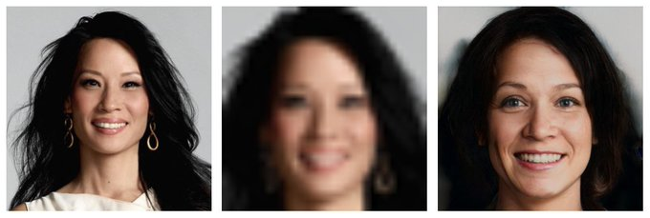
Data Integrity
Another example again:
Consider a program that takes a pixelated photo of a person and upscales it to a high-res portrait.
The majority of US LinkedIn users are Caucasian. It is reasonable to assume that a model trained on this data will tend to generate faces with Caucasian features.
https://www.theverge.com/21298762/face-depixelizer-ai-machine-learning-tool-pulse-stylegan-obama-bias Note…This article is kind of click bait.

Slide 43

Neural Network Variants
Modern deep learning research has led to a slew of architecture variants.
A few of interest are:
Convolutional neural networks
Recurrent neural networks
Autoencoders
Generative adversarial networks
https://www.asimovinstitute.org/author/fjodorvanveen/

Slide 44
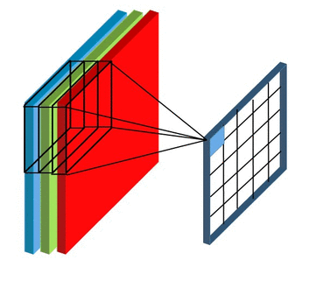
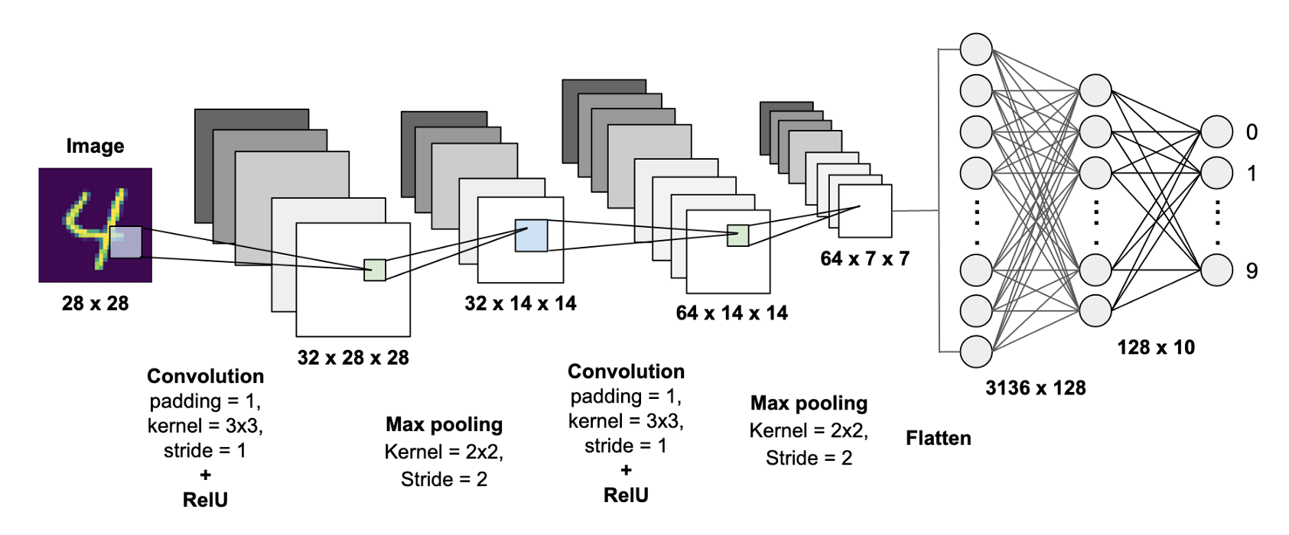
Convolutional Neural Networks
Convolutional neural networks (ConvNets, CNNs) are primarily used for image applications. They leverage “filters” that pass through images to detect meta-features, such as edges.
With this mechanism, CNNs have more success capturing complex visual patterns (eyes, whiskers, paws) and detecting objects in larger scenes (a cat in the corner of an image).
https://mc.ai/convolution-networks-for-dummies/

Slide 45
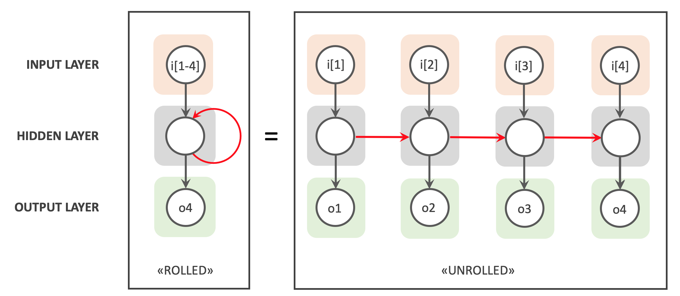
Recurrent Neural Network
Recurrent neural networks (RNNs) are primarily used for data in which historical context is important
temporal signals (speech, natural language, audio, time series data)
The network provides a mechanism for the previous n data points to influence the current training point’s network.
https://www.bouvet.no/bouvet-deler/explaining-recurrent-neural-networks

Slide 46
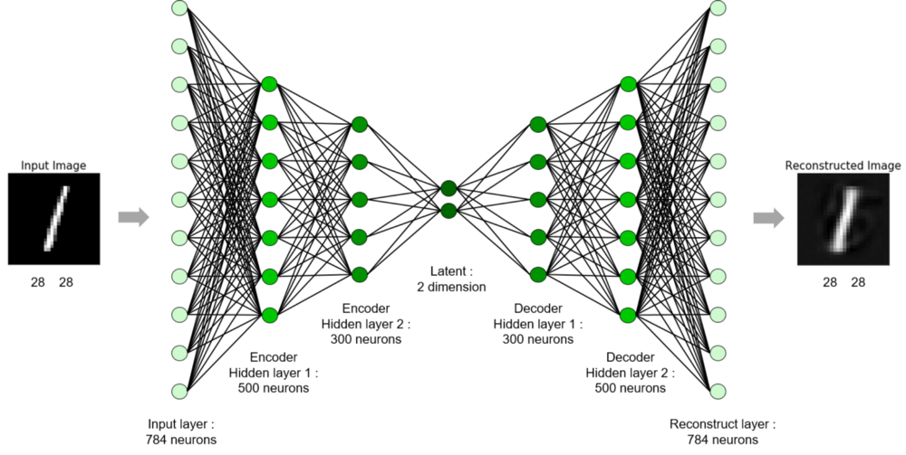
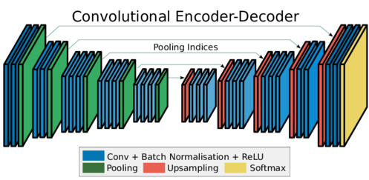
Autoencoders
Autoencoders learn a simpler representation (encoding) for complicated data.
Encoder
Simplify high dimensional space into a smaller representation (encoding)
Decoder
Expand an encoding back into the original data

Slide 47
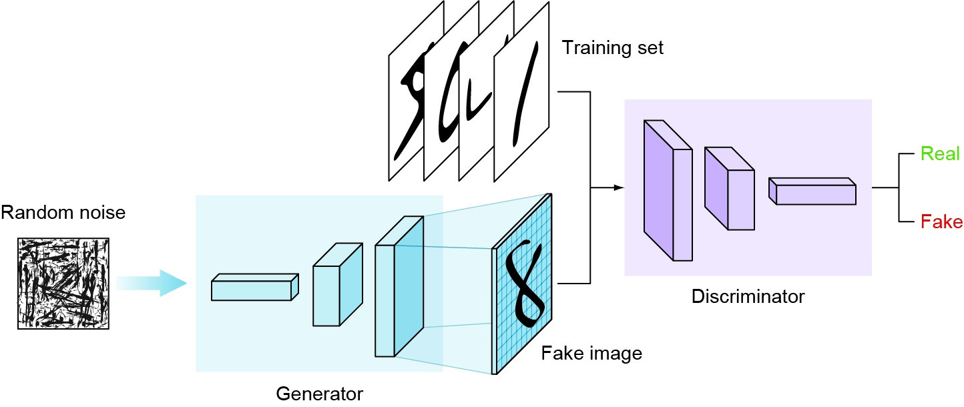
Generative Adversarial Networks (GANs)
Generative adversarial networks (GANs) are able to create hyper-realistic images, videos, music, and text.

Slide 48
Generative Adversarial Networks (GANs)
Generative adversarial networks (GANs) are able to create hyper-realistic images, videos, music, and text.
The generator takes in random numbers and returns an image
The generated image is fed into the discriminator alongside a stream of images taken from the ground-truth dataset
The discriminator takes in both real and fake images and predicts which are fake
The discriminator is used to improve the performance of the generator

Slide 49
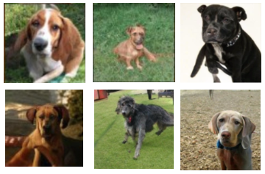
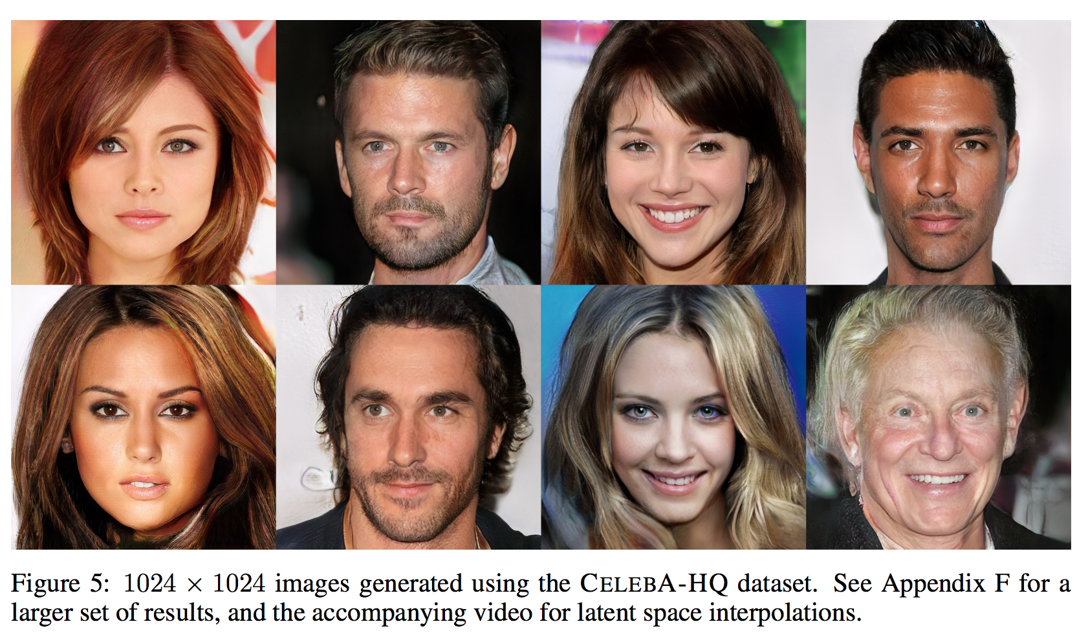
Generative Adversarial Networks (GANs)
Once complete, the generator can be used to generate fake data.
Below are examples of fake images of dogs and fake images of human portraits.
https://towardsdatascience.com/dcgans-generating-dog-images-with-tensorflow-and-keras-fb51a1071432
https://www.kaggle.com/c/generative-dog-images/discussion/97753
https://arxiv.org/pdf/1710.10196.pdf
https://medium.com/@kcimc/how-to-recognize-fake-ai-generated-images-4d1f6f9a2842

Slide 50
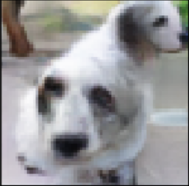
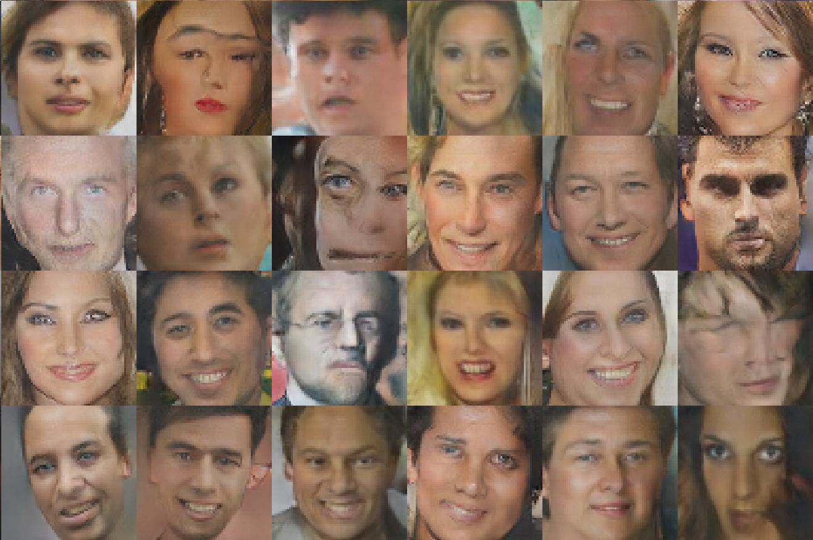
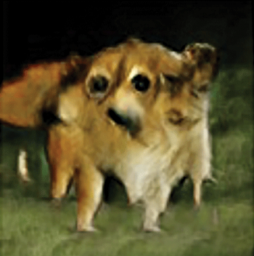
GANs – some Funny bad examples

Slide 51



Other open-source Python deep learning libraries

